Slide 1

libSBOL & pySBOL Bryan Bartley bartleyba@sbolstandard.org The Sauro Systems & Synthetic Biology Lab University of Washington, Seattle, WA

Slide 2
LibSBOL
C++ beta release on SynBioDex/libSBOL
Cross-platform on MacOSX and Windows. Uses CMake meta-build tool
SWIG-Python bindings on SynBioDex/pySBOL2 (uses setuptools for installation). Not yet available on PyPI
Getting Started Tutorial & API reference http://synbiodex.github.io/libSBOL
Sequence Assembly & Biosystem Design Tutorials http://synbiodex.github.io/libSBOL/sequences.html http://synbiodex.github.io/libSBOL/modular_design.html

Slide 3
Guiding Philosophy
User-experience: An object-oriented approach to synthetic biology
LibSBOL supports both open-world and SBOL-compliant object creation
Library implementation and specification document are intuitively correlated
Extensibility

Slide 4
User Experience

Slide 5
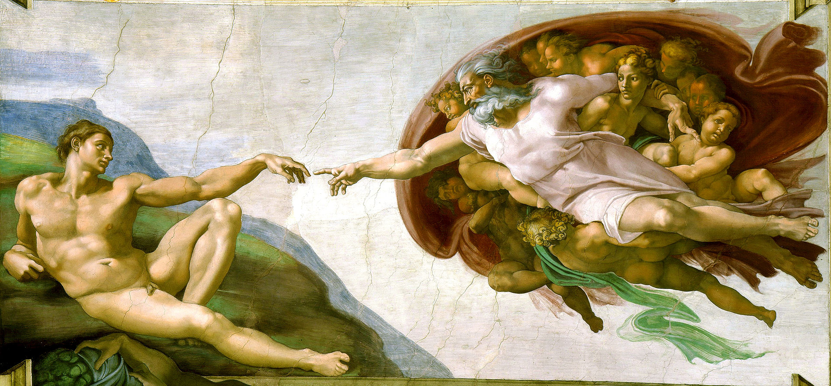
Building Designs with SBOL Should Be a Joyful Act of Creation

Slide 6
LibSBOL = Object-oriented Synthetic Biology
Synthetic biologists need to re-use and share biological components in the same way that programmers re-use and share software components. Synthetic biology needs an OOP framework.
LibSBOL’s API uses a terse, imperative, noun-verb syntax. Think about the Data Model first, then act.
EYFP_production.participations.create (C++)
vs
EYFP_production.createParticipation (Java)
Notes:
SBOL closely tied to software use-cases and data exchange.
What are the key concepts and ideas that use when imagining a design. What are the actions I want to perform on those objects
Close mapping between the standard, libraries, and the domain knowledge representation

Slide 7
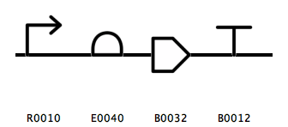
Automation of High-level Design Tasks
ComponentDefinition::assemble Assemble hierarchical DNA constructs; assemble template designs
Sequence::assemble Stitch together DNA sequences from different parts; replace cut-and-paste
ModuleDefinition::assemble Assembly of layered, regulatory gates and modular systems
BB13
Notes:
Why use SBOL not genbank?
Assemble template design first
Template designs specify general function using SO type not sequences
- Researcher might want a template and then instantiate different variants of the design
Researcher might not want to disclose information
Researcher might simply want a visual diagram of a circuit’s function

Slide 8
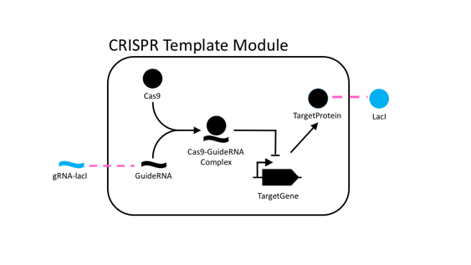
Other High-level Design Tasks in Today’s Tutorial
Connecting Module Inputs and Outputs
Mechanistic Modeling of Biochemical Interactions
Overriding Components in a Template Design

Slide 9
LibSBOL Supports Both Open-world and SBOL-compliant Object Creation

Slide 10
SBOL Objects are Uniquely Identified by Uniform Resource Identifiers (URI).
For purposes of today’s tutorial URIs consist of a scheme, a namespace, and an identifier.
A common scheme used is http://. An example namespace is sys-bio.org. And an example identifier might be my_design.
Thus, the complete URI is http://sys-bio.org/my_design

Slide 11
SBOL-Compliant Mode Simplifies URI Generation
Automates and simplifies URI construction.
Only top level objects (eg, ComponentDefinition, ModuleDefinition) use constructors; all other objects are constructed using create() methods.
Object creation and manipulation is closely tied to an SBOL Document. Implicitly assumes that data exchange is primary motivation for using the Data Model
SBOL-compliance is enabled in libSBOL by default

Slide 12
LibSBOL Also Supports a More “Open-world” Approach to Object Creation
Few restrictions placed on URIs.
Constructors are primary means of creating objects.
Objects can be manipulated independent from an SBOL Document.
Emphasizes other uses of Data Model for knowledge representation and computational biology. See my upcoming talk Version and Variant Control for Synthetic Biology at COMBINE 2016
For today’s tutorial, open-world approach should be avoided!

Slide 13
An Example Constructor
Sets default namespace for URI generation
setHomespace("http://sys-bio.org");
ComponentDefinition& TargetPromoter = *new ComponentDefinition
("TargetPromoter", BIOPAX_DNA);
TargetPromoter.roles.set(SO_PROMOTER)

Slide 14
An Example Constructor
The identifier for the URI.
In SBOL-compliant mode, this also sets the object’s displayId
setHomespace("http://sys-bio.org");
ComponentDefinition& TargetPromoter = *new ComponentDefinition
("TargetPromoter", BIOPAX_DNA)
TargetPromoter.roles.set(SO_PROMOTER)

Slide 15
An Example Constructor
After the identifier, comes 0 or more required fields. For ComponentDef’s
molecular type is required
setHomespace("http://sys-bio.org");
ComponentDefinition& TargetPromoter = *new ComponentDefinition
("TargetPromoter", BIOPAX_DNA);
TargetPromoter.roles.set(SO_PROMOTER)

Slide 16
An Example Constructor
setHomespace("http://sys-bio.org");
ComponentDefinition& TargetPromoter = *new ComponentDefinition
("TargetPromoter", BIOPAX_DNA);
TargetPromoter.roles.set(SO_PROMOTER)
Optional fields are set after construction

Slide 17
An Example Constructor
setHomespace("http://sys-bio.org");
ComponentDefinition& TargetPromoter = *new ComponentDefinition
("TargetPromoter", BIOPAX_DNA);
TargetPromoter.roles.set(SO_PROMOTER)
Some programmer’s might regard this syntax as bad form.
For a justification why I use this syntax, see: http://synbiodex.github.io/libSBOL/getting_started.html#idiomatic_cpp
Then send hate-mail to sbol-editors@googlegroups.com!

Slide 18
Library Implementation and Specification Document are Intuitively Correlated

Slide 19
From Specification Diagram to Class Definition
namespace sbol
{
class ComponentDefinition : public TopLevel
{
public:
List<URIProperty> types;
List<URIProperty> roles;
ReferencedObject sequence;
List<OwnedObject<SequenceAnnotation>> sequenceAnnotations;
List<OwnedObject<Component>> components;
List<OwnedObject<SequenceConstraint>> sequenceConstraints;
…
}
LibSBOL’s API is built around basic accessor methods and RDF triple serialization methods
at the level of SBOL Properties, not SBOL Classes.

Slide 20
Validation Rules Cross-Reference to the Spec Document and are Easily Extensible
Identified(sbol_type type = UNDEFINED, std::string uri_prefix = SBOL_URI, std::string id = “Identified/example”) :
identity(SBOL_IDENTITY, this, uri_prefix + "/" + id, ”,
validation_rules = { sbol_rule_10202 })
{
};

Slide 21
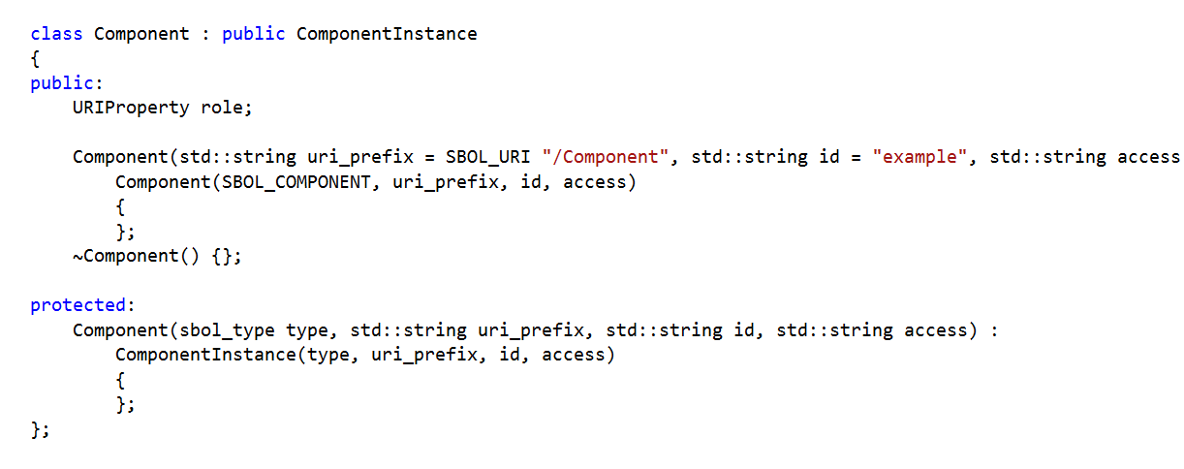
Easy to Implement Future Enhancements in the SBOL Data Model
SBOL 2.0.0

Slide 22
Easy to Implement Future Enhancements in the SBOL Data Model
SBOL 2.0.1

Slide 23
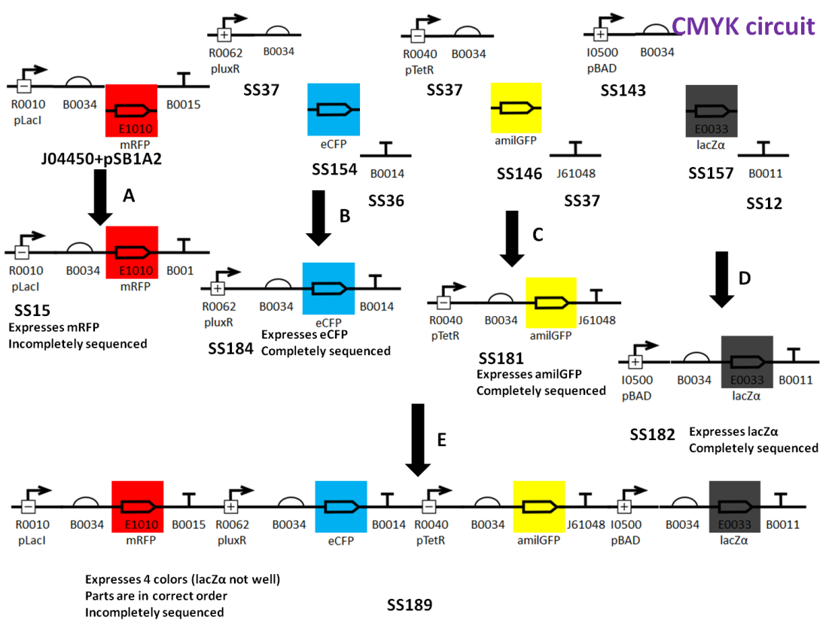
Easy to Write Application-Specific Annotations and Custom Extensions
Notes:
Need tutorial for writing custom extensions
Pythonize the pySBOL interface
Implement validation rules

Slide 24
Host Context Extension
#define EXTENSION_PREFIX "host_context"
#define EXTENSION_NS "sys-bio.org/HostContext#"
#define EXTENSION_CLASS "Host"
class Host : public ModuleDefinition
{
Host(sbol_type type, std::string uri) :
ModuleDefinition(type, uri),
modules(EXTENSION_NS "modules", this),
parents(EXTENSION_NS "parents", this),
children(EXTENSION_NS "children", this),
generation(EXTENSION_NS "generation", this, 1),
medium(EXTENSION_NS "medium", this, "www.ebi.ac.uk/efo/EFO_0000579"),
vendorId(EXTENSION_NS "vendorId", this, "sigmaaldrich.com/L2542")
{
register_extension < Host > (EXTENSION_PREFIX, EXTENSION_NS EXTENSION_CLASS);
};
}

Slide 25
Host Context Serialization
<?xml version="1.0" encoding="utf-8"?>
<rdf:RDF xmlns:dcterms="http://purl.org/dc/terms/#"
xmlns:host_context="sys-bio.org/HostContext#"
xmlns:prov="http://www.w3.org/ns/prov#"
xmlns:rdf="http://www.w3.org/1999/02/22-rdf-syntax-ns#"
xmlns:sbol="http://sbols.org/v2#">
<host_context:Host rdf:about="sys-bio.org/BB1">
<sbol:persistentIdentity rdf:resource="sys-bio.org/BB1"/>
<host_context:generation>1</host_context:generation>
<host_context:medium rdf:resource="www.ebi.ac.uk/efo/EFO_0000579"/>
<host_context:vendorId>sigmaaldrich.com/L2542</host_context:vendorId>
</host_context:Host>
<sbol:ModuleDefinition rdf:about="sys-bio.org/CRISPRTemplate">
<sbol:persistentIdentity rdf:resource="sys-bio.org/CRISPRTemplate"/>
</sbol:ModuleDefinition>
<sbol:ModuleDefinition rdf:about="sys-bio.org/CRPbCircuit">
<sbol:persistentIdentity rdf:resource="sys-bio.org/CRPbCircuit"/>
</sbol:ModuleDefinition>
</rdf:RDF>

Slide 26
Concluding Remarks

Slide 27
pySBOL API
Generated from libSBOL using Simplified Wrapper and Interface Generator (SWIG)
API closely resembles C++ API with a few exceptions:
No new operator required for object constructions
No templated methods, thus:
doc.get<ComponentDefinition>() becomes doc.getComponentDefinition()
Use lists instead of vectors
For today’s tutorial, if working in Python, use the C++ API reference and methods

Slide 28

To Do
`Pythonize’ the pySBOL interface. To see what’s possible, try pySBOL 1
Implement validation rules
Write tutorial for extension developers

Slide 29
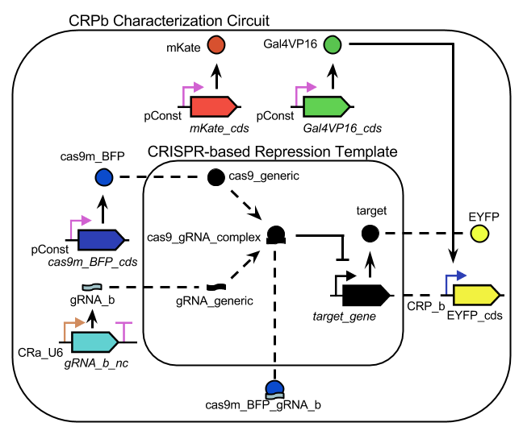
Tutorial Assignment: CRISPR Characterization Circuit
Notes:
What is the template? What do the mappings means
Work in pairs, break down into tasks you are most interested in
Pair biologist with developers

Slide 30

Please try out!

Slide 31
Acknowledgements
Anil Wipat and the Newcastle team
Chris Myers and the Utah team
The SBOL Editors
NSF Collaborative awards #1355909
Kyle Medley
PhD Student
Kiri Choi
PhD Student
Herbert Sauro,
Associate Professor of Bioengineering

